Slide 1

INSTITUTE :UIE
DEPARTMENT: ACADEMIC UNIT 4
Bachelor of Engineering (EE Branch)
Subject Name and Code:
Engineering Physics 23SPH-141
Prepared by: Divya, Assistant Prof. Physics
i
Superconductivity
DISCOVER . LEARN . EMPOWER

Slide 2

COURSE OBJECTIVES
The course is designed to make the students industry ready to contribute in the growing demand of the industry at local, national and international level.
It will make the students competent to understand basic concepts and applications of advanced engineering physics and apply its principles in their respective fields at global platform.
It will enhance the skill level of the students and shall make them preferred choice for getting employment in industry and research labs.
It will give thorough knowledge of the discipline to enable students to disseminate knowledge in pursuing excellence in academic areas.

Slide 3
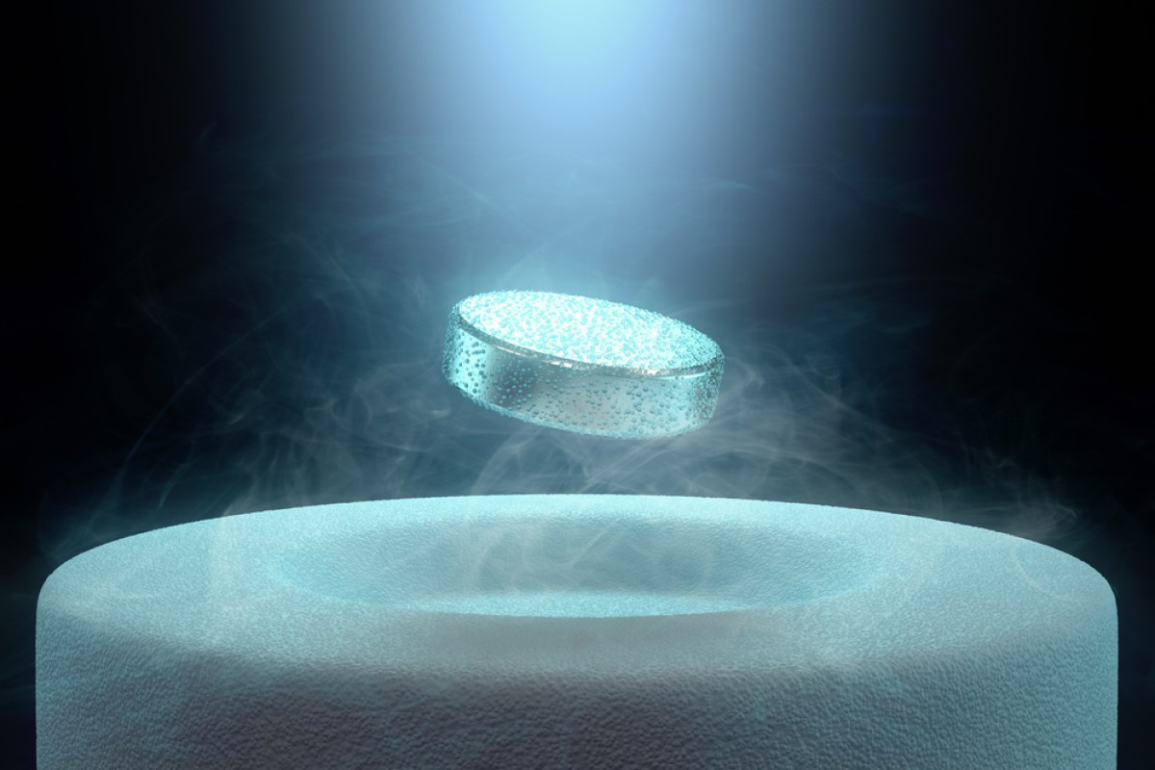
Course Outcomes
CO Number | Title On completion of this course, the students are expected to learn | Level
CO1 | To identify various components of laser and optical fibers and justify their importance and applications in different fields of science and technology | Understand Applying
CO2 | The basic concepts of semiconductor physics, illustrate the working of various semiconductor components and use its principles in design of optoelectronic devices and its applications. | Understand Applying Analyze
CO3 | To understand the principles of superconductivity and their applications. To illustrate the propagation of em waves. | Understand Applying

Slide 4
CONTENT
INTRODUCTION TO SUPERCONDUCTORS
CRITICAL TEMPERATURE

Slide 5
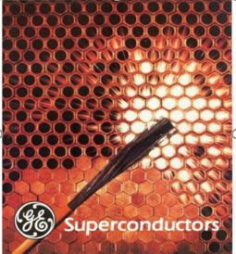

Introduction to Superconductors
Superconductivity is a phenomena in certain materials at extremely low temperatures, characterized by exactly zero electrical resistance and exclusion of the interior magnetic field(i.e the Meissner effect).
This phenomenon is nothing but losing the resistivity absolutely when cooled to sufficiently low temperatures.
Fig.1

Slide 6
Introduction to Superconductors
Because the resistance of a piece of superconductor is zero, there are no heat losses for currents through them; they are used in magnets needing high currents, such as in MRI machines, and could cut energy losses in power transmission.
But most superconductors must be cooled to temperatures only a few kelvin above absolute zero, a costly procedure limiting their practical applications. In the past decade, tremendous advances have been made in producing materials that become superconductors at relatively high temperatures. There is hope that room temperature superconductors may someday be manufactured.

Slide 7
Differentiating Conductor and a Superconductor
The resistance of a metallic conductor decreases gradually as temperature is lowered due to decrease of vibrational resistance of atoms. In ordinary conductors such as copper or silver, this decrease is limited by impurities and other defects. Even at absolute zero, a real sample of a normal conductor shows some resistance.
In a superconductor, the resistance drops abruptly to zero when the material is cooled below its critical temperature.
An electric current flowing through a loop of superconducting wire can persist indefinitely with no power source.

Slide 8
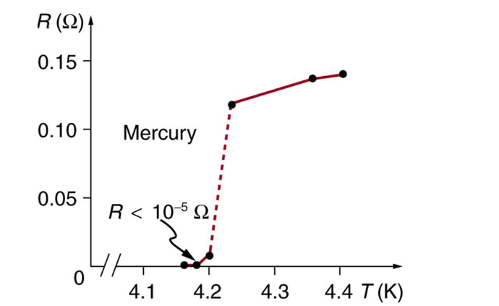
Critical Temperature
Superconductivity was discovered accidentally in 1911 by the Dutch physicist H. Kamerlingh Onnes (1853–1926) when he used liquid helium to cool mercury. Onnes had been the first person to liquefy helium a few years earlier and was surprised to observe the resistivity of a mediocre conductor like mercury drop to zero at a temperature of 4.2 K. We define the temperature at which and below which a material becomes a superconductor to be its critical temperature, denoted by Tc.
Fig.2

Slide 9
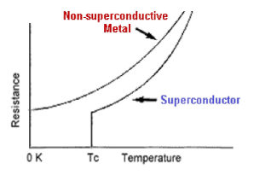
Critical Temperature
The temperature at which resistivity becomes zero, and material transforms from normal conducting to superconducting phase is called transition or critical temperature(Tc).
Below Tc resistance is becoming zero turning into superconducting state.
Fig.3

Slide 10
ASSESSMENT PATTERN
MST(02)
20 marks
Quiz
4 marks
Attendance
(>90%)
2 marks
Surprise test
4 marks
Assignment
10 marks

Slide 11
Reference Books and Weblinks
http://hyperphysics.phy-astr.gsu.edu/hbase/Solids/scond.html#:~:text=The%20critical%20temperature%20for%20superconductors,described%20by%20the%20BCS%20theory.
https://en.wikipedia.org/wiki/Superconductivity
https://www.ques10.com/p/31326/define-super-conductivity-and-critical-temperature/

Slide 12
Reference Video links
https://www.youtube.com/watch?v=h6FYs_AUCsQ
https://www.youtube.com/watch?v=RS7gyZJg5nc
https://www.youtube.com/watch?v=3gKRIjUzIH4

Slide 13
THANK YOU
For queries
Email: divya.e8645@cumail.in

